Slide 1
FILE HANDLING IN PYTHON
Dr. Manoj Varshney
ASST. PROFESSOR
T&D DEPT.
GLA UNIVERSITY,
MATHURA

Slide 2
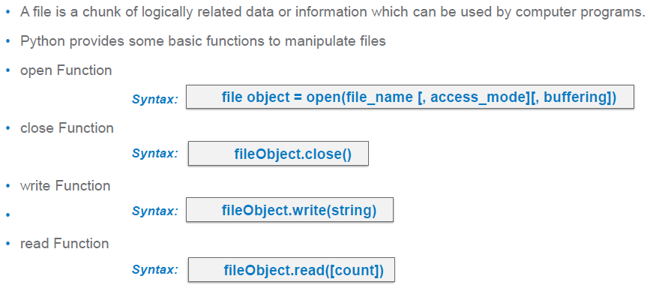
File Operations

Slide 3
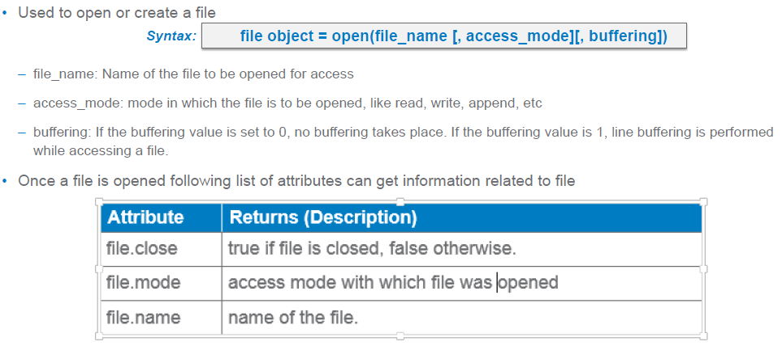
1. open()

Slide 4
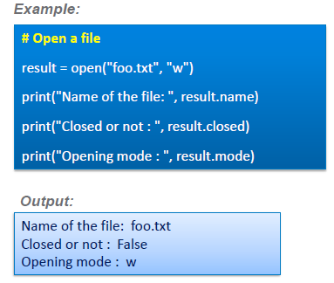
Example

Slide 5
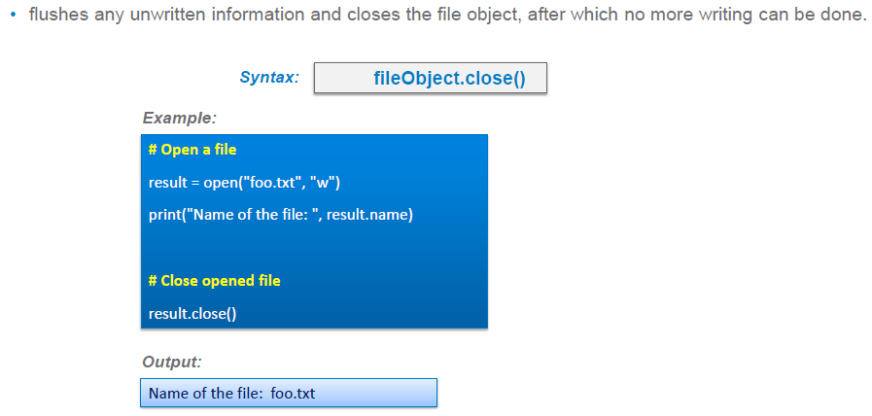
2. close()

Slide 6
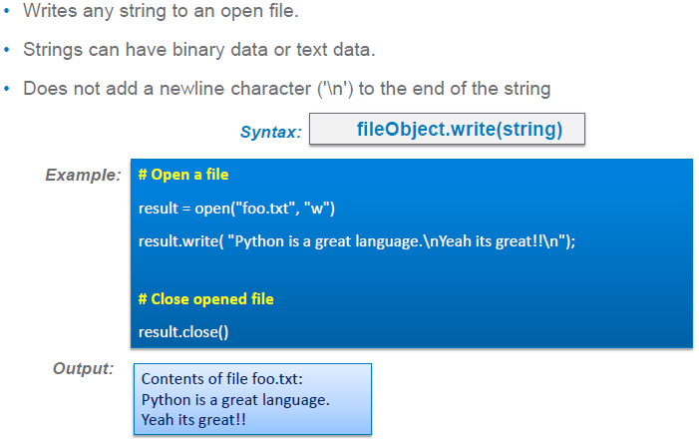
3. write()

Slide 7
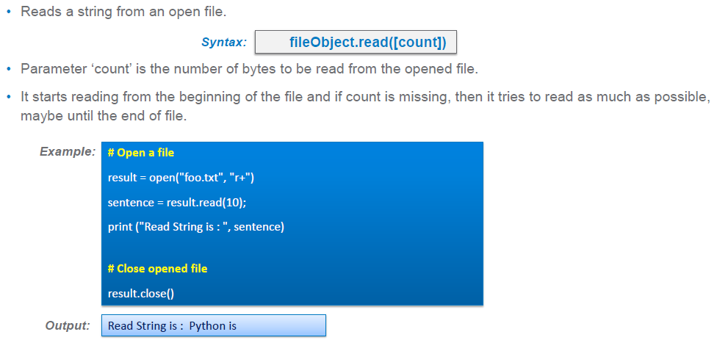
4. read()

Slide 8
Other functions
To read contents from file
1. fp.read(n) :- n is the number of bytes to read
2. fp.readline():- It will read only one line that is point by fp.
3. fp.readlines(): It will all the lines of the file and store all the lines in list
To write contents into the file
1. fp.writelines(l):- It will write all the lines present in the list l

Slide 9
Programs
1. WAP to write starting 10 even numbers in the output file output1.txt ( in single line)
2. WAP to write starting 10 odd numbers in the output file output2.txt ( in multiple lines)
3. WAP to write 5 random numbers between 50-60(both inclusive) in the output file output3.txt ( in single line)
4. WAP that reads data from a file and calculates the percentage of vowels and consonants in the file

Slide 10
Prgrams
5. WAP that accepts filename as an input from the user. Open the file and count the number of times a character(I/P from user) appears in the file
6. WAP that copies one Python Script into another in such a way that all comment lines are skipped and not copied in the destination file.
7. WAP to enter the name of the file and print the longest line present in the file.

Slide 11
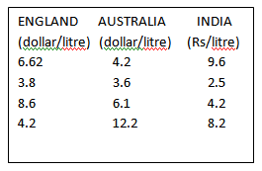
8. Write a Python program to read a file (“input.txt”) of oil prices in England , Australia and India. Output the average oil price of each country to an output file output.txt.(Note: All fields are separated with one space)

Slide 12
Modes of opening the file
Text File | Binary File
r | rb
w | wb
a | ab
r+ | rb+
w+ | wb+
a+ | ab+
x | xb

Slide 13
with keyword
We can open the file using with keyword.
Example:
s=fp.read()
The advantage of using with keyword is “File is properly closed after it is used even if an error occurs during read or write operation or even when you forget to explicitly close the file”
with open(“a.txt“,”r”) as fp:
s=fp.read()
print(s)

Slide 14
Other useful File methods
fp.fileno() :- It returns the file number of the file (File Descriptor)
fp.truncate(n) :- Resizes the file to n bytes
fp.tell():- It tells the current position of the file pointer
fp.seek(byteoffset,reference) :-It is used to move the file pointer fp to a new location.

Slide 15
Assignment
1. WAP that reads a file line by line. Each line read from the file is copied to another file with line numbers specified at the beginning of the line.
For example, if contents of file is as follows:
Hello
Bye
GLA
Expected O/P:
1. Hello
2. Bye
3. GLA

Slide 16
2. WAP that counts the number of tabs, spaces and newline characters in a file
3. WAP that counts the number of characters, words and lines in a file
4. WAP that generates a Quiz and uses two files-Questions.txt and Answers.txt . The program opens Questions.txt and reads a question and displays the question with options on the screen. The program then opens the Answers.txt file and displays the correct answers.

Slide 17
5. WAP to read first n lines from the file.
6. WAP to read last n lines from the file.
7. WAP to read from m line to n line.
8. WAP to write all the prime numbers from 2 to 100 to the output file output1.txt
9. WAP to append all the armstrong numbers from 100 to 999 to the above file outfile1.txt

Slide 18
10. WAP to write only those lines in the output file that starts with 172
Input File
Hello Raj
172.16.42.35
165.72.42.1
127.0.01
172.12.12.10
17.13.11.10
Expected O/P:
172.16.42.35
172.12.12.10

